Slide 1





Components and Data Binding
The building blocks of our application
Components
And
Data Binding
SoftUni Team
Technical Trainers
Software University
http://softuni.bg

Slide 2

Table of Contents
Components: Basic Idea
Creating Components
Bootstrapping & Modules
Data Bindings & Templates
Lifecycle Hooks
Component Interaction
Services with Fake Data

Slide 3
Have a Question?
sli.do #js-web

Slide 4

Components: Basic Idea
The main building block

Slide 5
The Idea Behind Components
A component controls part of the screen (the view)
You define application logic into the component
Each component has it's own HTML/CSS template
import { Component } from '@angular/core';
@Component({
selector: 'app-root',
template: `<h1>{{title}}</h1>`,
styles: [ `h1 {
background-color: red;}` ]
})
export class AppComponent { title = 'App Title'; }
Unique html template and styling

Slide 6
The Idea Behind Components
App Root Component
Navigation Component
All Articles Component
Components can interact with each other
Article Component

Slide 7


Creating Components
And their unique templates

Slide 8
Creating Components Manually
In order to create a component we need the Component decorator.
It provides metadata and tells Angular that we are creating a Component and not an ordinary class.
import { Component } from '@angular/core';
We call it whilist adding '@' infront and pass in metadata.
@Component({
selector: 'app-home',
template: '<h1>Home View</h1>'
})

Slide 9
Creating Components Manually 2
Component Metadata
selector – the component's HTML selector
template or templateUrl – the component's the template
styles or styleUrls – unique styles for the current component
providers – list of providers that can be injected using DI
selector: 'app-home'
templateUrl: 'Path to template'
styleUrls: 'Array of paths'

Slide 10
Creating Components Manually 3
Angular needs to know how the pieces of your application fit together and what other files and libraries the app requires.
After the creation of the component we need to add it in the declarations array at the app module.
NgModules help organize an application into cohesive blocks of functionality.
@NgModule({
declarations: [
AppComponent,
HomeComponent
]

Slide 11



Creating Components with the CLI
We can use the Angular CLI to generate a new component
The CLI creates a new folder src/app/home/
The CLI directly imports the component in the app module
ng generate component home

Slide 12

Bootstrapping
Starting the application

Slide 13
Bootstrapping An Application
An NgModule class describes how the application parts fit together
Every application has at least one NgModule – the root module
It is used to bootstrap (launch) the application
Usually it is called AppModule but it is not necessary
platformBrowserDynamic().bootstrapModule(AppModule)

Slide 14
The Initial Module
import { BrowserModule } from '@angular/platform-browser';
import { NgModule } from '@angular/core';
import { AppComponent } from './app.component';
@NgModule({
declarations: [ AppComponent ],
imports: [ BrowserModule ],
providers: [],
bootstrap: [ AppComponent ]
})
export class AppModule { }
The @NgModule tells Angular how to compile and launch the app

Slide 15

Initial Module Properties
The declarations array
Only declarables – (components, directives and pipes)
The imports array
Only @NgModule classes – integrated (HttpClientModule, BrowserModule) or custom made

Slide 16

Initial Module Properties (2)
The providers array
Register service providers and inject them into components
The bootstrap array
The root component – used to launch the application
Inserting a bootstrapped component usually triggers a cascade of component creation

Slide 17
Data Bindings & Templates
Template
View
Model
Repeater, Enhanced Syntax

Slide 18
Templates & Data Bindings Overview
A template is a form of HTML that tells Angular how to render the component
They can be both inline or in a separate file
We can render array properties using *ngFor repeater
We can render nested properties of an object
We can render condition statements using *ngIf
We can attach events and handle them in the component

Slide 19
Render an array using *ngFor
export class GamesComponent {
private games : Game[]; constructor() {
this.games = [ // Array of games ]
}
}
<h1>Games List</h1>
<p>Pick a game to Buy</p>
<ul>
<li *ngFor="let game of games">
{{game.title}}
</li>
</ul>
The '*' symbol is required infront

Slide 20
Conditional statements using *ngIf
<h1>Games List</h1>
<p>Pick a game to Buy</p>
<ul>
<li *ngFor="let game of games">
<div>
{{game.title}}
</div>
<span *ngIf="game.price >= 100">-> Price: {{game.price}}</span>
</li>
</ul>

Slide 21
Attach Events
<button (click)="showContent($event)">Show Content</button>
export class GamesComponent {
public games: Game[];
showContent: boolean;
constructor() {
this.games = [ // Array of games ]
}
showAdditionalContent($event) {
this.showContent = true;
}}
Binding events in a template

Slide 22
Binding Attributes
Binding attributes
export class GamesComponent {
imgUrl: string; constructor() {
this.imgUrl = "a url to an image"
}
<img [attr.src]="imgUrl" />
The name of the property in the component

Slide 23
Binding css classes or specific class name
Binding classes
You can bind to a specific class name
<div [class]="badCurly">Bad curly</div>
<div [class.special]="isSpecial">The class binding is special</div>
<div class="special"
[class.special]="!isSpecial">This one is not so special</div>
Toggle class "special" on/off

Slide 24
Binding styles or styles with units
Binding styles
Or styles with units
<button [style.color]="isSpecial ? 'red': 'green'">Red</button>
<button [style.background-color]="canSave ? 'cyan': 'grey'" >Save</button>
<button [style.font-size.em]="isSpecial ? 3 : 1" >Big</button>
<button [style.font-size.%]="!isSpecial ? 150 : 50" >Small</button>

Slide 25
Reference other elements in template
You can reference other elements
You can also use the ref- prefix
<input #phone placeholder="phone number">
<button (click)="callPhone(phone.value)">Call</button>
Phone refers to the input element
<input ref-phone placeholder="phone number">
<button (click)="callPhone(phone.value)">Call</button>

Slide 26
Pipes and null-safe opearator
You can add pipes
You can also use the null-safe operator
<div>Title through uppercase pipe: {{game.title | uppercase}}</div>
<div>Birthdate: {{user.birthdate | date:'longDate'}}</div>
<div>{{game | json}}</div>
<div>Title through a pipe chain:{{game.title | uppercase | lowercase}}</div>
<div>The current hero's name is {{game?.title}}</div>
<div>The null hero's name is {{game && game.name}}</div>
<div *ngIf="nullHero">The null hero's name is {{game.name}}</div>
Remove the whole div

Slide 27
Template Expressions
The text between the curly brackets is evaluated to a string
Template expressions are not pure JavaScript
You cannot use these
Assignments (=, +=, -=, ...)
The new operator
Multiple expressions
Increment or decrement operations (++ or --)
Bitwise operators
<p>The sum of two + two + four is {{2 + 2 + 4}}</p>

Slide 28
Types of Data Binding
There are three types of data binding
{{expression}}
[target]="expression"
bind-target="expression"
From data-source to view
From view to data-source
(target)="statement"
on-target="statement"
Two-way
[(target)]="expression"
bindon-target="expression"

Slide 29
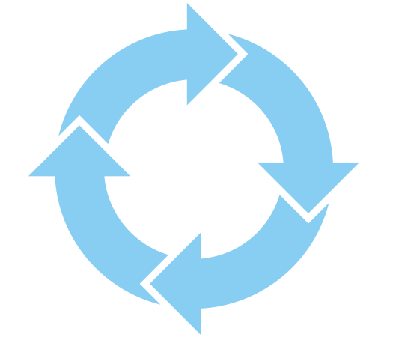
Lifecycle Hooks
Intersect through the loop

Slide 30



Lifecycle Overview
A component has a lifecycle managed by Angular
Angular offers lifecycle hooks that provide control over life moments of a component.
Directive and component instances have a lifecycle as Angular creates, updates and destroys them.

Slide 31
ngOnInit and ngOnDestroy Example
import { Component, OnInit, OnDestroy } from '@angular/core';
@Component({..})
export class GamesComponent implements OnInit, OnDestroy {
games: Game[];
ngOnInit() {
this.games = [] // Load games from a service
}
ngOnDestroy() {
console.log('DELETED');
}
}
Called shortly after creation
Used for cleanup

Slide 32
Other Lifecycle Hooks
All lifecycle hooks:
ngOnChanges() – when data is changed
ngDoCheck() – detect your own changes
ngAfterContentInit() – when external content is received
ngAfterContentChecked() – when external content is checked
ngAfterViewInit() – when the views and child views are created
ngAfterViewChecked() – when the above are checked
Read more at: https://angular.io/guide/lifecycle-hooks

Slide 33

Component Interaction
Passing data in between

Slide 34
From Parent to Child
import { Component, Input } from '@angular/core';
import { Game } from '../games/game';
@Component({
selector: 'game',
template: `
<li><div>{{game.title | uppercase}}<span *ngIf="game.price >= 100">-> Price: {{game.price}}</span></div></li>`
})
export class GameComponent {
@Input('gameProp') game : Game;
}
The prop will come from above.

Slide 35
From Parent to Child 2
<h1>Games List</h1>
<p>Pick a game to Buy</p>
<ul>
<game *ngFor="let game of games"
[gameProp]="game">
</game>
</ul>
<button (click)="showAdditionalContent()">Show Image</button>
Render the child into the parent template and pass the needed prop

Slide 36
Component Interaction
In order to pass data from child to parent component we need the Output decorator and an Event Emitter.
import { …, Output, EventEmitter } from '@angular/core';
import { Game } from '../games/game'; @Component({ … })
export class GameComponent {
@Input('gameProp') game : Game;
@Output() onReacted = new EventEmitter<boolean>();
react(likeOrDislike : boolean) {
this.onReacted.emit(likeOrDislike); }
}
The parent will bind the event

Slide 37
Component Interaction
The Parent component handles the event
@Component({ template: `<game *ngFor="let game of games"[gameProp]="game"
(onReacted)="onReacted($event)">
</game>` })
export class GamesComponent {
games: Game[];
likes : number;
dislikes : number;
onReacted(likeOrDislike: boolean) {
likeOrDislike ? this.likes++ : this.dislikes++; }
}
Function passed by Event Emitter

Slide 38

Creating Custom Services
Making your own fake data

Slide 39
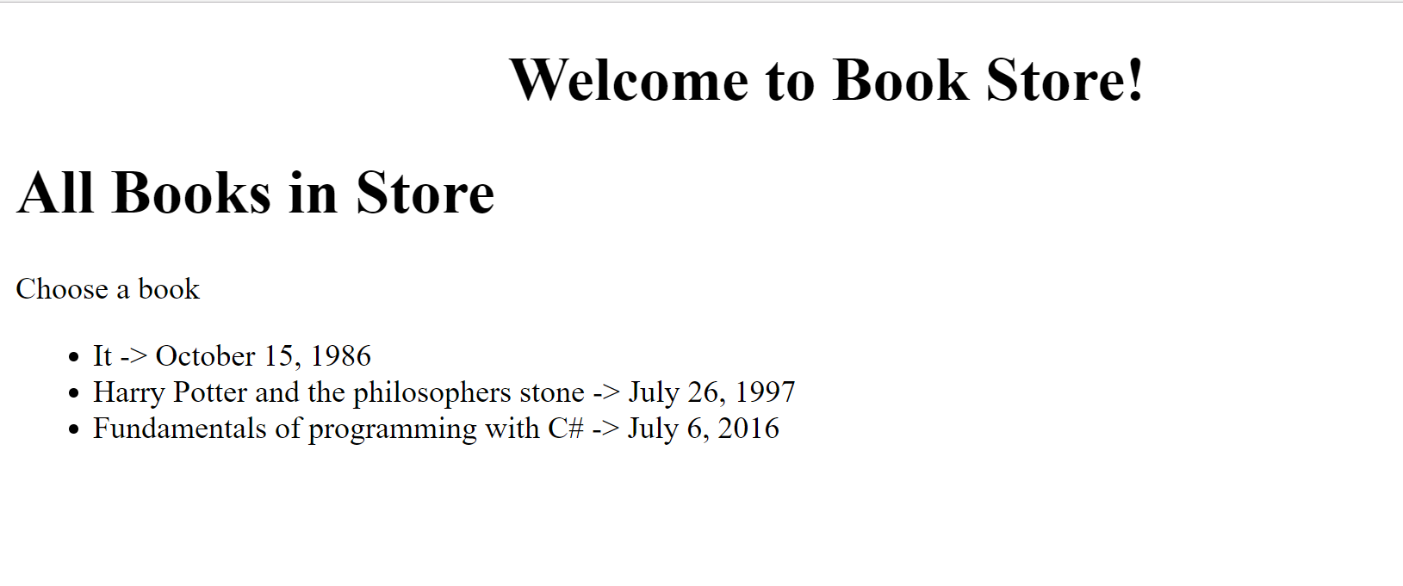
Problem: Create a Simple Book Store
Create Books component
Create a BooksData class to store the information

Slide 40
Create Book Model
Create a Book class to hold information about a book
Title, author, price and published on (date)
export class Book {
title : string;
author : string;
price : number;
publishedOn : Date;
constructor(title : string, author : string, price : number, publishedOn : Date) {
// bind the parameters to the properties
}}

Slide 41
Create a Data Class
Create a data class that returns an array of books
import { Book } from "./book";
export class BooksData {
getData() : Book[] {
return [
new Book('It', 'Stephen King', 23.2, new Date(1986, 9, 15)),
new Book('Harry Potter and the philosophers stone', 'J.K Rowling', 22.1, new Date(1997, 6, 26)),
new Book('Fundamentals of programming with C#', 'Svetlin Nakov', 50, new Date(2016, 6, 6)),
]}
}

Slide 42
Create a Component
Create a books component and use the service
import { Component, OnInit } from '@angular/core'
import { BooksService } from './books.service'
@Component({ selector: 'books', templateUrl: '…'})
export class BooksComponent implements OnInit {
public books : Book[];
ngOnInit(): void {
this.books = new BooksService().getData();
}
}
Creating instances is wrong! We will learn why in the next lecture.

Slide 43
Summary
Each Component has it's own template
There are three types of data-binding
We can intersect the lifecycle of a component
Components can interact with each other
@Component({ selector: 'app', template: `<h1>{{title}}</h1`})
ngOnInit() { this.data = // Retrieve data }
@Output() fromParent = new EventEmitter<boolen>();

Slide 44












Components and Data Binding
https://softuni.bg/courses/

Slide 45
License
This course (slides, examples, demos, videos, homework, etc.) is licensed under the "Creative Commons Attribution-NonCommercial-ShareAlike 4.0 International" license
Attribution: this work may contain portions from
"End-to-end JavaScript Applications" course by Telerik Academy under CC-BY-NC-SA license

Slide 46





Trainings @ Software University (SoftUni)
Software University – High-Quality Education, Profession and Job for Software Developers
softuni.bg
Software University Foundation
http://softuni.foundation/
Software University @ Facebook
facebook.com/SoftwareUniversity
Software University Forums
forum.softuni.bg

